Slide 1


Presentation for Selected-2 project
Presented By:
زياد أحمد محمد رفعت : 202000351
معاذ ناصر عبدالعزيز العزب : 202000925
نادر سعيد جلال السيد : 202000975
نور الدين ايمن عيسي سليمان : 202001000
فاطمه سعيد فؤاد محمد : 202000634
سهيله سيد البس موافي : 202000408
تقي اسامه حسن : 202000229

Slide 2
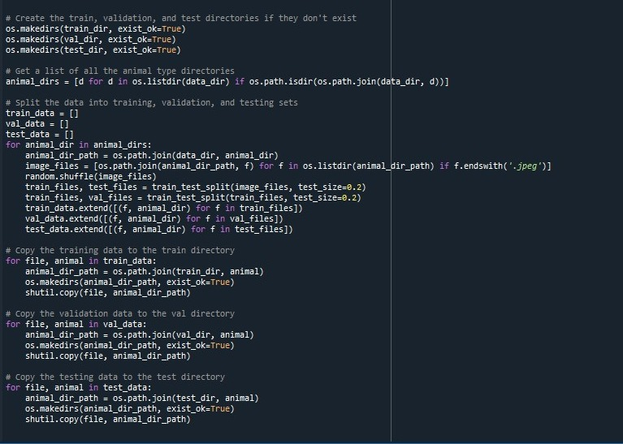
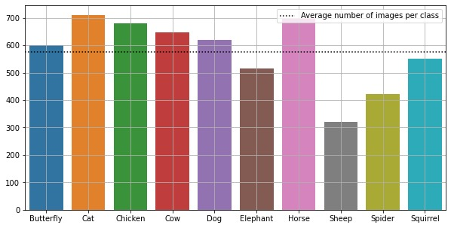
Plot. Fig
First at all : collect animals name from folder
Pick this data and looping in animals dares and pick every animal and joined animal name with main path.
Image file : is a list put in it all images after check the all images extension “.jpeg”
Make random data at list.
Make function train _test_split to split data from image file.
This split by :60% training set , 20 % testing set , 20% validation set
Split data in suitable filel.

Slide 3
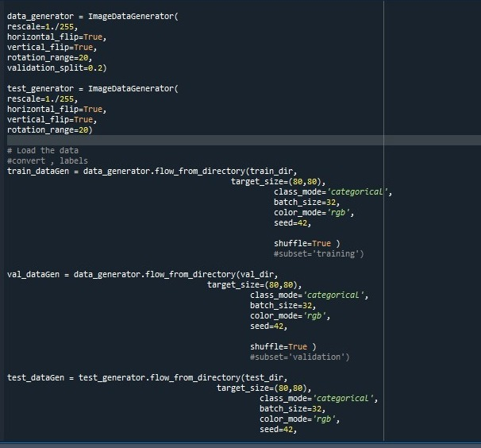
Data augmentation and pre processing
Use image data generator function to pre processing in data to prepare to the model.
Use flow_from_director to convert pexels to array of integer.
Automation rename for all imges from name of file.
And make target size 80*80

Slide 4
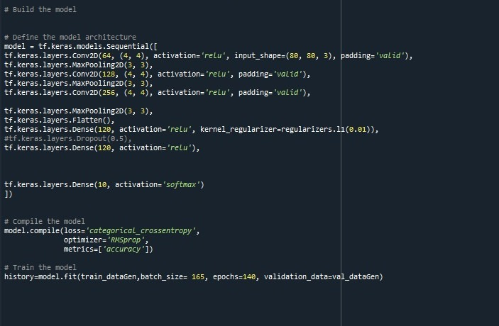
Model
Start with convolution layer number of filter 64 size every filter 4*4 and input_shape (80 , 80 , 3 ) use 3 for RGB
Activation “relu” because we need all result positive numbers
Padding “valid” because to make value of activation near to be fixed
Max poinet try to minimize feature for every image
Flatten convert matrix to one column to can get in module for Ann
Dense number of neurons 120 and use regularization program this value 0.01
Activation softmax to get prediction values for every class
Stride = 1.

Slide 5
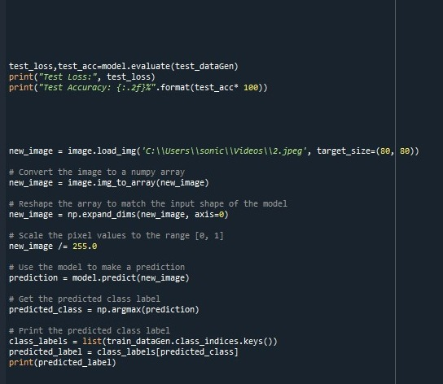
Make prediction
First print test loss
Second test accuersy and predict specific image

Slide 6
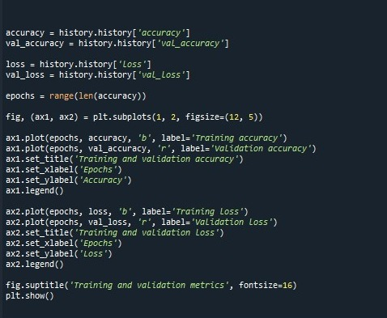
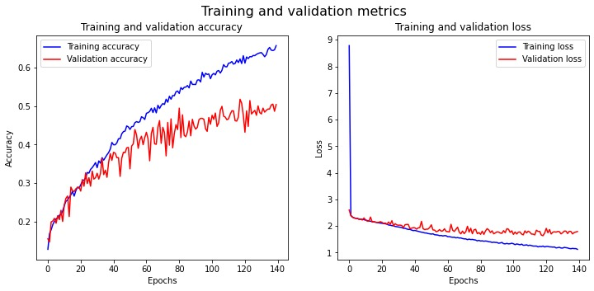
Plots
Fig1: relation between accuracy and epochs (training and validation accuracy)
Fig2: relation between loss and epochs (training and validation loss)

Slide 7

resources
Git hub link :
https://github.com/Moaz108/AnimalDetection.git
Dataset link :
https://www.kaggle.com/datasets/alessiocorrado99/animals10
Paper link :
https://www.shs-conferences.org/articles/shsconf/pdf/2022/14/shsconf_stehf2022_03017.pdf

Slide 8
Thank you

